Slide 1

LOGIT AD-CLICK
MINI PROJECT

Slide 2


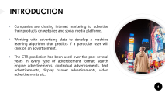
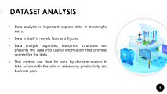
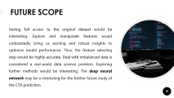
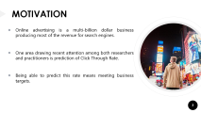

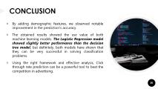
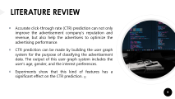
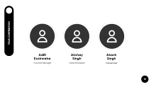
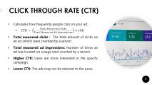

CONTENT

Slide 3

MOTIVATION
Online advertising is a multi-billion dollar business producing most of the revenue for search engines.
One area drawing recent attention among both researchers and practitioners is prediction of Click Through Rate.
Being able to predict this rate means meeting business targets.

Slide 4
INTRODUCTION
Companies are chasing internet marketing to advertise their products on websites and social media platforms.
Working with advertising data to develop a machine learning algorithm that predicts if a particular user will click on an advertisement.
The CTR prediction has been used over the past several years in every type of advertisement format, search engine advertisements, contextual advertisements, text advertisements, display banner advertisements, video advertisements etc.

Slide 5
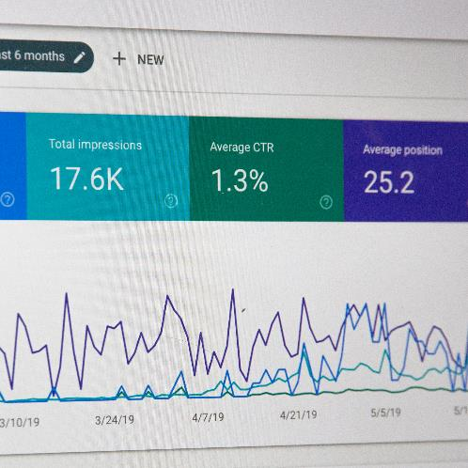
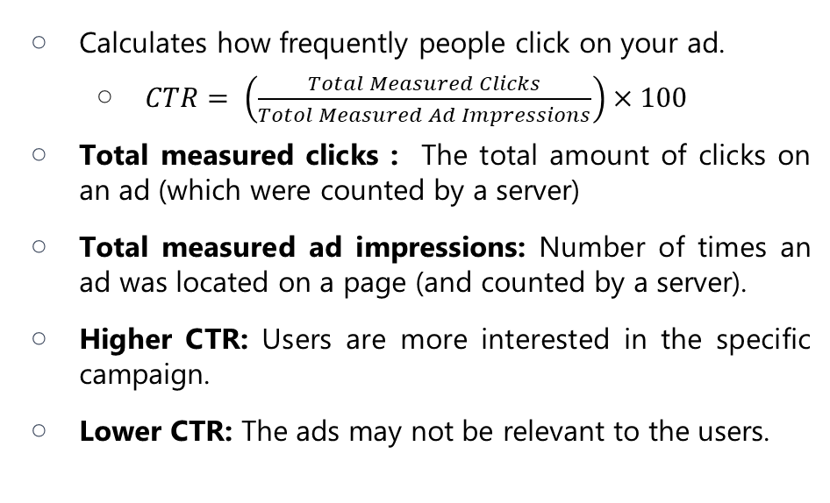
CLICK THROUGH RATE (CTR)
Calculates how frequently people click on your ad.
$CTR= \left(\frac{Total Measured Clicks}{Totol Measured Ad Impressions}\right)×100$
Total measured clicks : The total amount of clicks on an ad (which were counted by a server)
Total measured ad impressions: Number of times an ad was located on a page (and counted by a server).
Higher CTR: Users are more interested in the specific campaign.
Lower CTR: The ads may not be relevant to the users.

Slide 6

LITERATURE REVIEW
Accurate click-through rate (CTR) prediction can not only improve the advertisement company’s reputation and revenue, but also help the advertisers to optimize the advertising performance.
CTR prediction can be made by building the user graph system for the purpose of classifying the advertisement data. The output of this user graph system includes the user’s age, gender, and the interest preferences.
Experiments show that this kind of features has a significant effect on the CTR prediction. [1]

Slide 7
HOW DO WE DO IT?
DATA ANALYSIS
MODEL TRAINING
MODEL IMPROVEMENT
FINAL MODEL
1
2
3
4

Slide 8

DATASET ANALYSIS
Data analysis is important explore data in meaningful ways.
Data in itself is merely facts and figures.
Data analysis organizes, interprets, structures and presents the data into useful information that provides context for the data.
This context can then be used by decision-makers to take action with the aim of enhancing productivity and business gain.

Slide 9
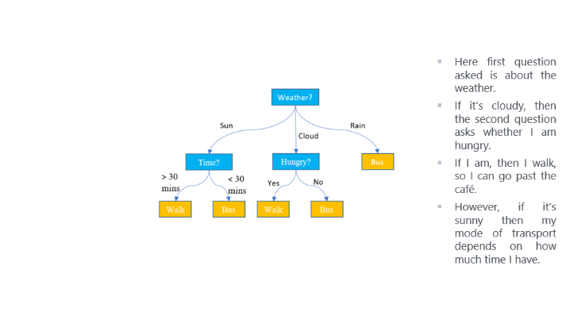
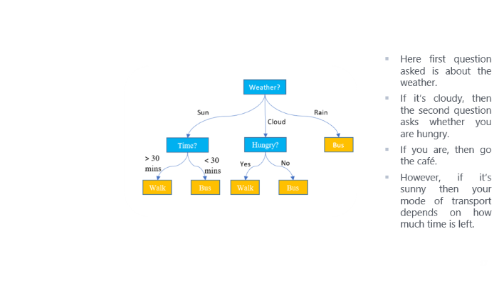
DECISION TREES
The Decision Tree is one of the most commonly algorithm for analysis and modeling. It is used for classification, prediction, estimation, clustering, data description, and visualization. [2]
The advantages of Decision Trees, compared to other data mining techniques are simplicity and computation efficiency.
Disadvantages :
Decision-tree learners can create over-complex trees that do not generalize the data well. This is called overfitting.
Decision trees can be unstable because small variations in the data might result in a completely different tree being generated. This is called variance.

Slide 10
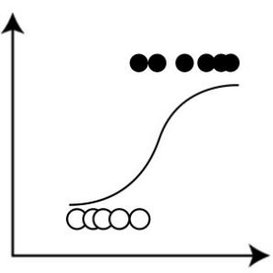
LOGISTIC REGRESSION
Logistic Regression is a Machine Learning algorithm which is used for the classification problems, it is a predictive analysis algorithm and based on the concept of probability.[3]
It can only be used when the target variables fall into discrete categories.
Few examples:
Predicting if an email is spam or not spam
Whether a tumor is malignant or benign
Whether a mushroom is poisonous or edible.

Slide 11
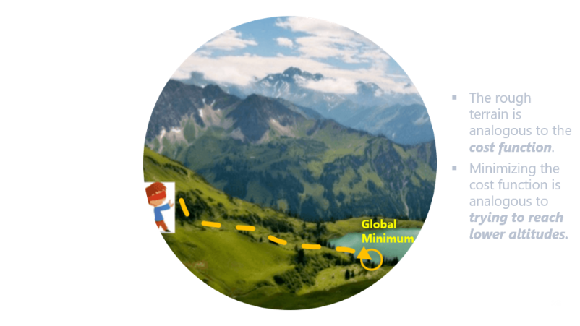
GRADIENT DESCENT
Gradient Descent is one of the most popular and widely used optimization algorithms. Given a machine learning model with parameters (weights and biases) and a cost function to evaluate how good a particular model is, our learning problem reduces to that of finding a good set of weights for our model which minimizes the cost function.
Variants of Gradient Descent
Batch Gradient Descent
Stochastic Gradient Descent
Mini-batch Gradient Descent

Slide 12
Variants of Gradient Descent
Batch gradient descent computes the gradient of the cost function w.r.t to parameter w for entire training data.
Stochastic gradient descent (SGD) computes the gradient for each update using a single training data point (chosen at random).
In mini-batch gradient descent, we calculate the gradient for each small mini-batch of training data.

Slide 13

NATURAL LANGUAGE PROCESSING
NLP is a field in machine learning with the ability of a computer to understand, analyze, manipulate, and potentially generate human language.
Machine learning for NLP helps data analysts turn unstructured text into usable data and insights.
Examples:
Information Extraction (Gmail structures events from emails).
Auto-Predict (Google Search predicts user search results).
Sentiment Analysis (Hater News gives us the sentiment of the user).

Slide 14
Python 3.8
Easy to code
Python is Portable language
Large Standard Library
NumPy
Contains a multi-dimensional array
It can be utilized to perform a number of mathematical operations on arrays.
Pandas
Matplotlib
Seaborn
Scikit-learn
NLTK
Provides a really fast and efficient way to manage and explore data.
Organization and labeling of data.
Simple and efficient tools for predictive data analysis.
Simple and efficient tools for predictive data analysis
Accessible to everybody, and reusable in various contexts.
Data visualization library based on matplotlib.
Drawing attractive and informative statistical graphics.
Library to work with human language data.
provides easy-to-use interfaces such as Word-Net.
Kaggle
Kaggle, a subsidiary of Google LLC, is an online community of data scientists and machine learning practitioners. .
REQUIREMENTS

Slide 15
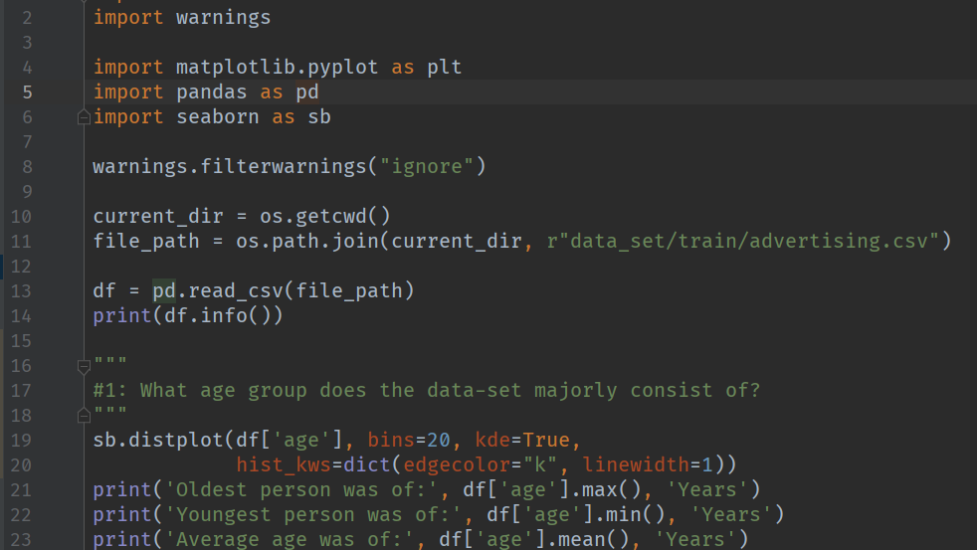
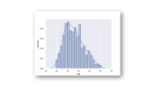
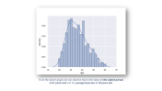
Dataset Analysis Example
Notes:
Discuss graph

Slide 16
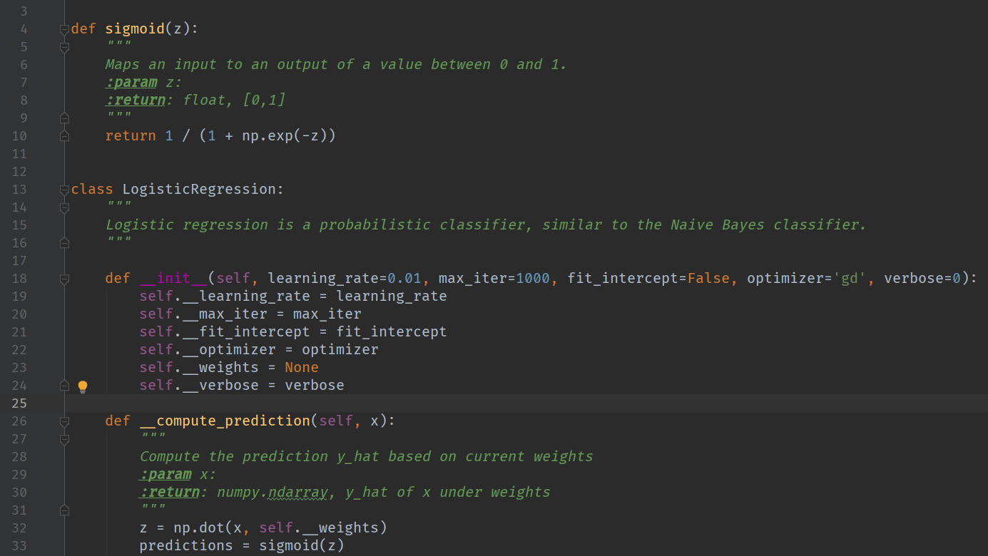
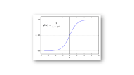
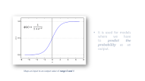
ML Model Example
Notes:
Discuss sigmoid function

Slide 17
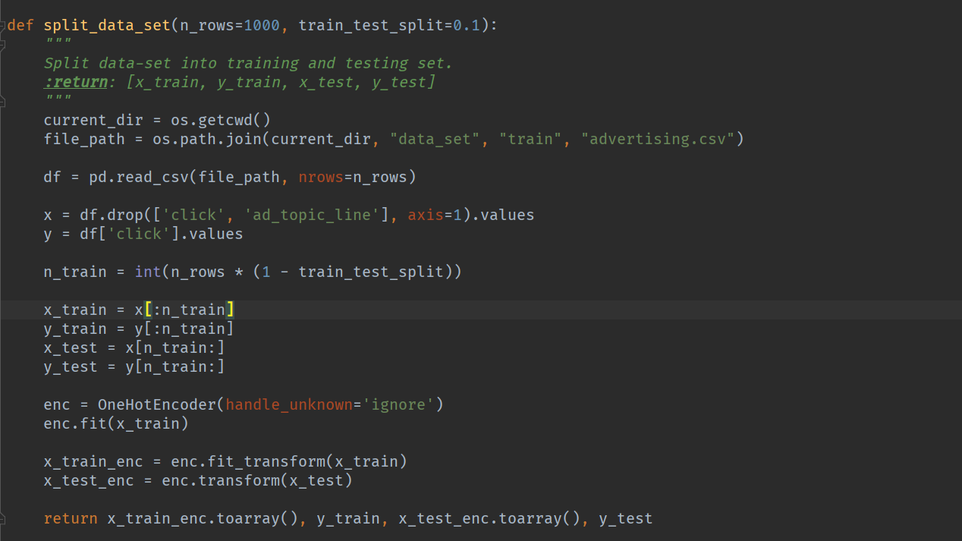
Splitting Dataset
Notes:
Train and split

Slide 18
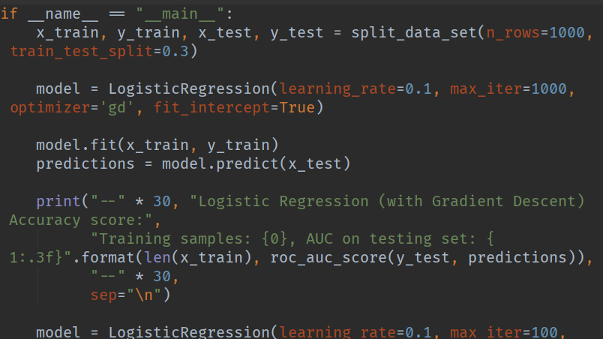
Model Training Example
Notes:
Model training

Slide 19
Aditi Kushwaha
Akshay Singh
Content Manager
Lead Developer
Developer
Akash Singh
TEAM CONTRIBUTION

Slide 20
CONCLUSION
By adding demographic features, we observed notable improvement in the prediction’s accuracy.
The obtained results showed the use value of both machine learning models. The Logistic Regression model showed slightly better performance than the decision tree model, but definitely, both models have shown that they can be very successful in solving classification problems.
Using the right framework and effective analysis, Click through rate prediction can be a powerful tool to beat the competition in advertising.

Slide 21
FUTURE SCOPE
Having full access to the original dataset would be interesting. Explore and manipulate features would undoubtedly bring us exciting and robust insights to optimize model performance. Thus, the feature selecting step would be highly accurate. Deal with imbalanced data is considered a real-world data science problem. Exploring further methods would be interesting. The deep neural network may be a interesting for the further future study of the CTR prediction.

Slide 22
SEN ZHANG, QIANG FU, WENDONG XIAO (2017). Advertisement Click-Through Rate Prediction Based on the Weighted-ELM and Adaboost Algorithm. Scientific Programming, vol. 2017, Article ID 2938369. https://www.hindawi.com/journals/sp/2017/2938369/ [1].
PRASHANT GUPTA (2017). Decision Trees in Machine Learning. https://towardsdatascience.com/decision-trees-in-machine-learning-641b9c4e8052 [2].
AYUSH PANT (2019). Introduction to Logistic Regression. https://towardsdatascience.com/introduction-to-logistic-regression-66248243c148 [3].
BADREESH SHETTY (2018). Natural Language Processing(NLP) for Machine Learning. https://towardsdatascience.com/natural-language-processing-nlp-for-machine-learning-d44498845d5b [4].
AURELIEN GERON (2017). Hands-On Machine Learning with Scikit-Learn, Keras, and TensorFlow: Concepts, Tools, and Techniques to Build Intelligent Systems.
EDWARD LOPER, EWAN KLEIN, AND STEVEN BIRD (2009). Natural Language Processing with Python.
REFERENCES

Slide 23
Thank You

Slide 24
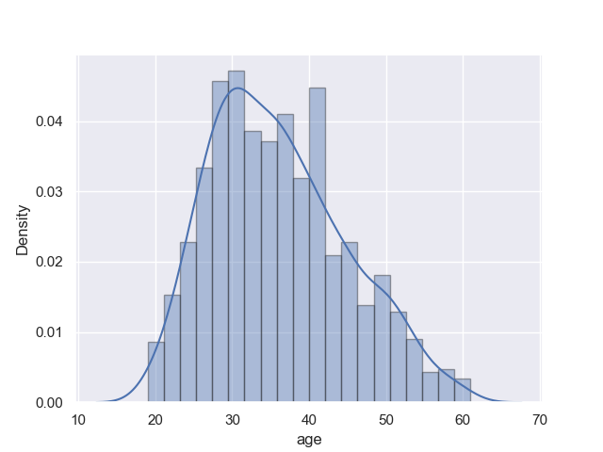
From the above graph, we can observe that in the data-set the oldest person is 61 years old and the youngest person is 19 years old.

Slide 25

It is used for models where we have to predict the probability as an output.
Maps an input to an output value of range 0 and 1.

Slide 26
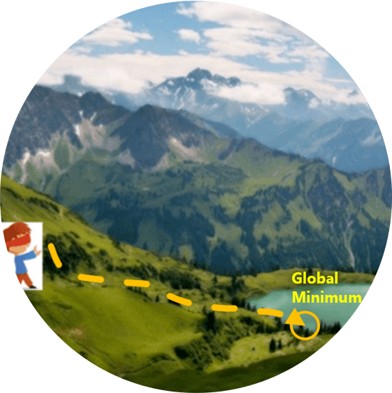
The rough terrain is analogous to the cost function.
Minimizing the cost function is analogous to trying to reach lower altitudes.

Slide 27
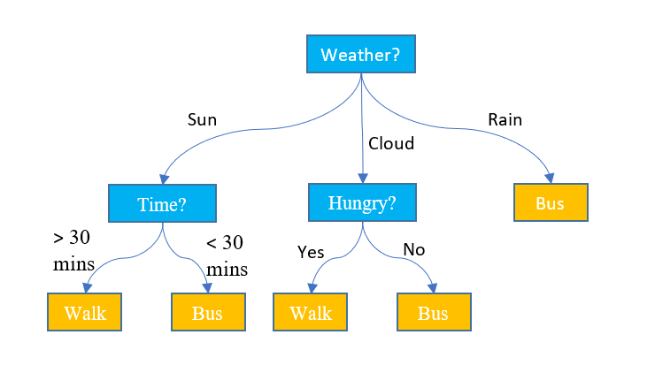
Here first question asked is about the weather.
If it’s cloudy, then the second question asks whether you are hungry.
If you are, then go the café.
However, if it’s sunny then your mode of transport depends on how much time is left.

Slide 28
FEASABILITY STUDY

